Slide 1

Flexible & Powerful Open Source Multi-Protocol Messaging
Group 5

Slide 2


Slide 3
ActiveMQ by Apache
Developed by the Apache Software Foundation
Stable release in August 28, 2019
(V 5.15.10 /)
Message-oriented middleware (MOM)
Allows loose coupling of the elements
Java based-makes use of the Java Message Service (JMS) API

Slide 4
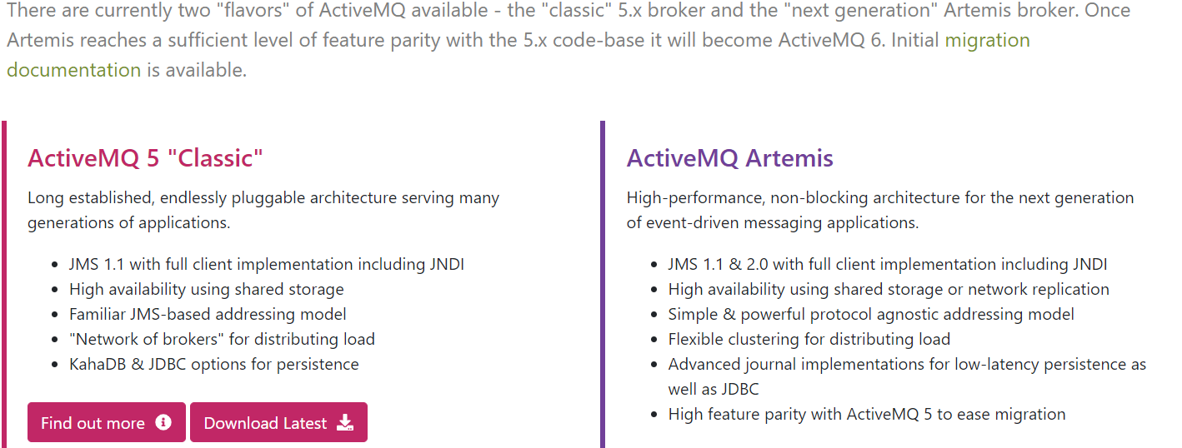
https://activemq.apache.org/

Slide 5
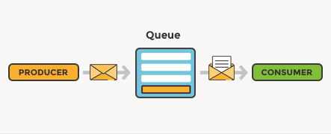
What is message queuing?
Allows applications to communicate by sending messages to each other.
Provides temporary message storage when the destination program is busy or not connected.
Producer:
Can be a component, person from where the message is originated.
eg: Payee system wanting communicate with HR
Consumer:
Can be a component, person to where the message is going.

Slide 6

Normal message passing:
Producer
Consumer

Slide 7
What if the message gets lost?
Producer
Consumer
1
Producer
Consumer
2
What if the message order gets mixed?

Slide 8
?
Producer
Consumer
?

Slide 9

Consumer 1
?
Producer
Consumer 2
Consumer 3

Slide 10

Example by scenario:
The creation of a product if done with ActiveMQ

Slide 11
1.Client send requirements to Lead dev
Active MQ:
LeadDeveloper
Client 1
Developer 2
Client 2
Developer 3

Slide 12

2.Lead dev asking something(to elaborate) from separate clients
Active MQ broker:
LeadDeveloper
Client 1
Queue 1
Developer 2
Client 2
Queue 2
Developer 3
Can store messages in queue

Slide 13

3.Lead dev assigning tasks to other developers
Active MQ broker:
LeadDeveloper
Client 1
Queue 1
Developer 2
Client 2
Developer 3
Queue 2
Developer 4

Slide 14

How does ActiveMQ work?

Slide 15
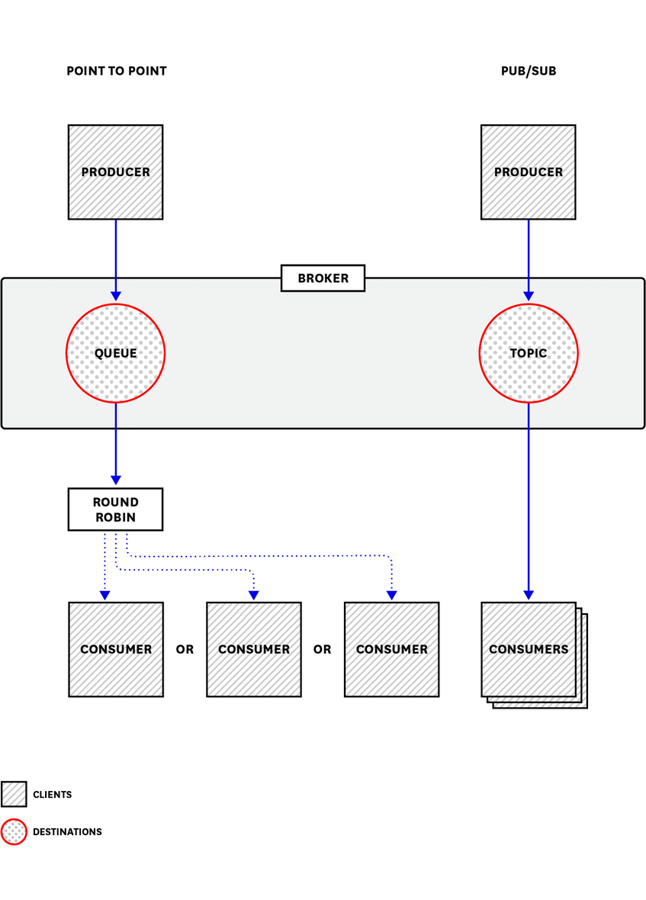
sends messages between client applications—producers, which create messages and submit them for delivery.
consumers receive and process messages.
The ActiveMQ broker routes each message through a queue
Each queue is matched with a topic.

Slide 16
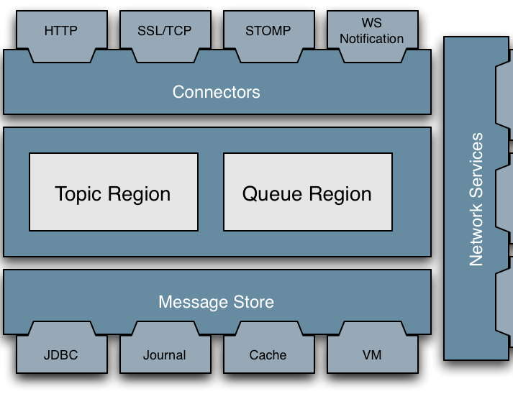
Architecture:

Slide 17
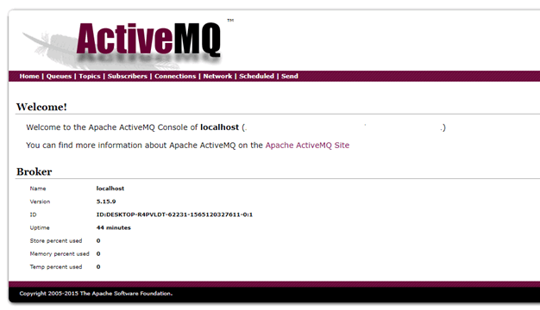
Once you have installed the ActiveMQ server it should be available at http://localhost:8161/admin

Slide 18
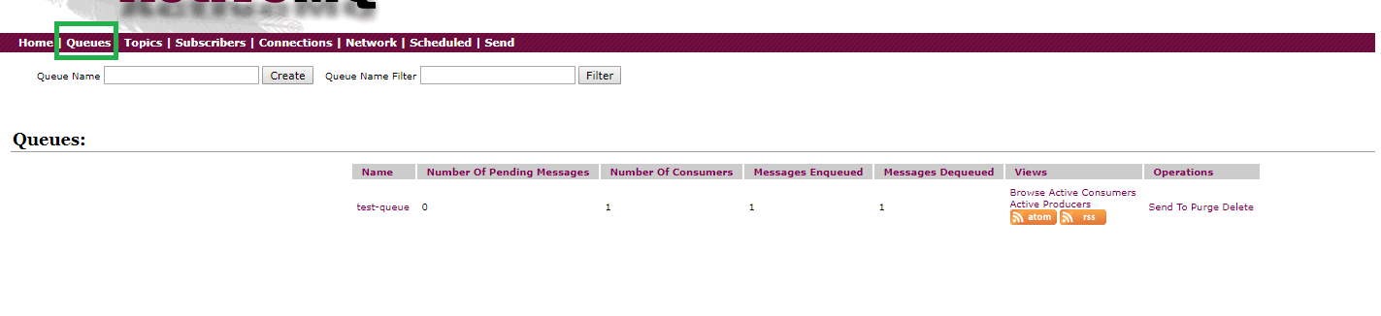
Dashboard stats:

Slide 19
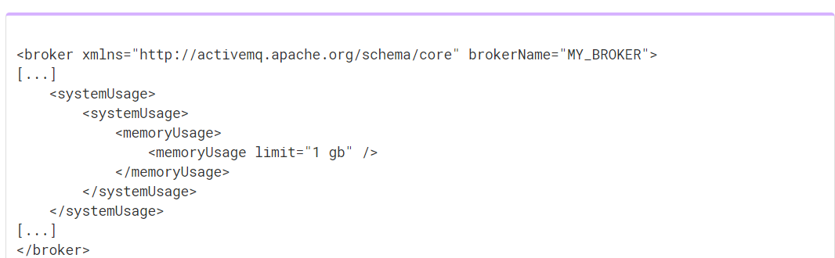
Memory:
Each message occupies some of the available memory until it is dequeued. Changeable in activemq.xml
How much memory depends on the size of the message.

Slide 20
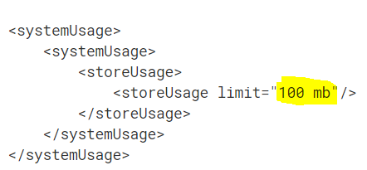

Storage:
KahaDB is ActiveMQ’s default message storage mechanism. It stores both persistent and non-persistent messages.

Slide 21

ActiveMQ metrics:
ActiveMQ metrics is a unique feature which can,
help you proactively maintain your messaging infrastructure
provide you with information you need to investigate,
errors
missing messages
unexpected latency.

Slide 22
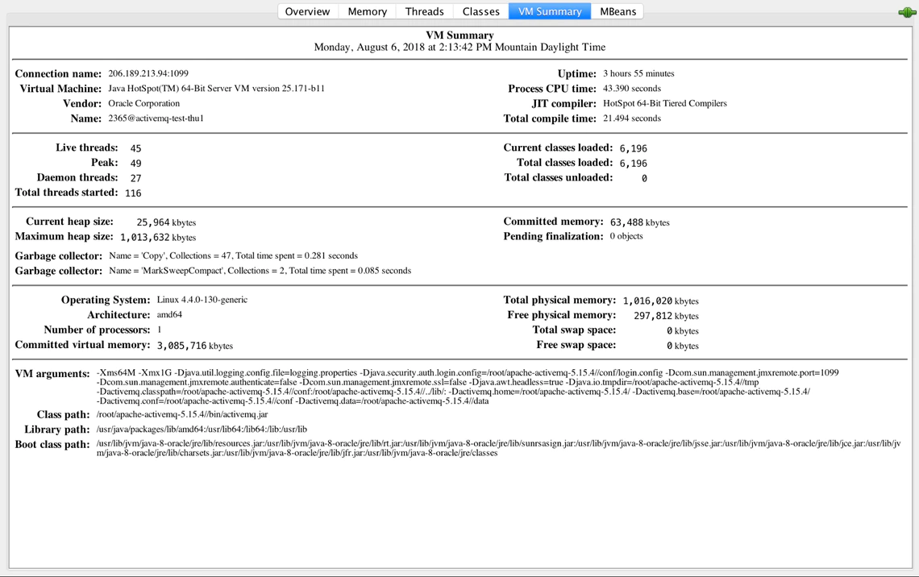
In addition to displaying metrics about ActiveMQ, JConsole shows you operating information about the JVM in which ActiveMQ is running. Under the VM Summary tab and Viewing ActiveMQ metrics in JConsole

Slide 23
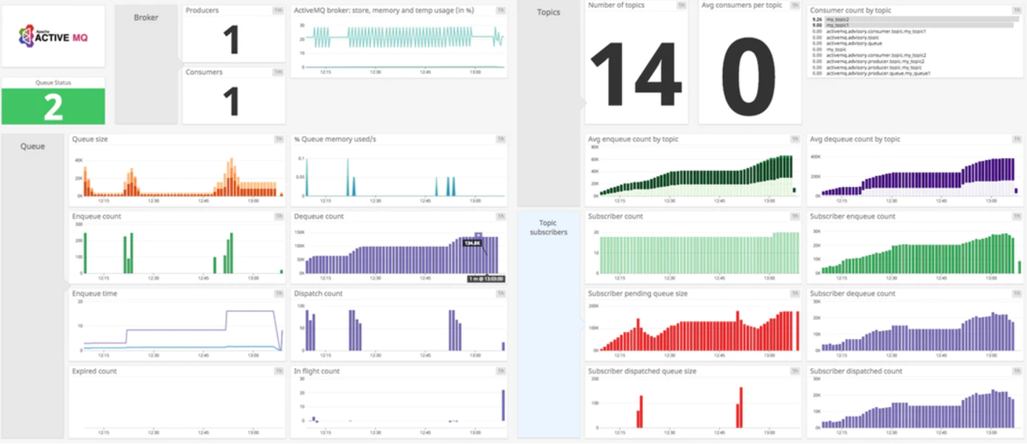

Slide 24



Organizations that use ActiveMQ
Lockheed :
Perform COTS integrations
Trimble:
To fulfill the need to perform the messaging between and the servers.
Caterpillar:
As a Message broker
Delta Dental of California
Sinclair Broadcast Group

Slide 25

Advantages
Open source
Allows applications build with different languages, OS and platforms to integrate with each other.
Location Transparency-Client applications doesn't need to know where the server applications are located.

Slide 26

Advantages contd.
Reliable Communications-Both the client and the server need not to be available at the same time.(due to the queues)
The size of the queue is dynamic(variable sized queues).

Slide 27

Advantages contd.
Less time consumption-Due to the asynchronous communication.
Reduced coupling-The information of the service can be changed easily with our effecting the client.
Easy coding.(ActiveMQ uses JAVA where others use Erlang)

Slide 28
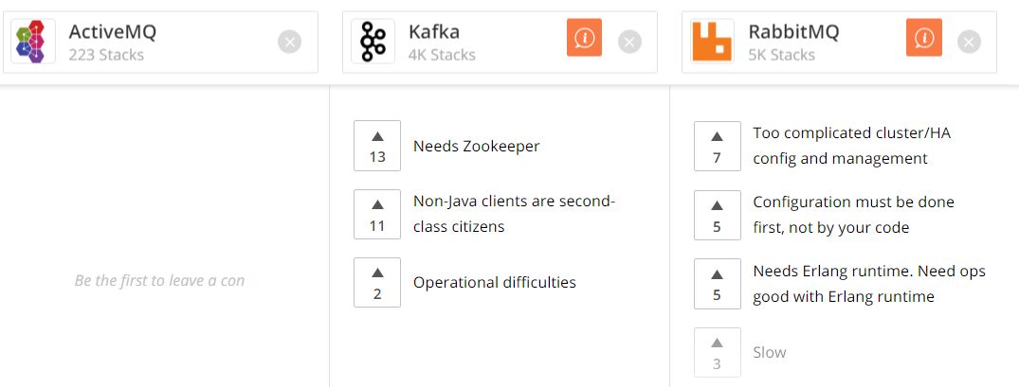
Disadvantages:
https://stackshare.io/stackups/activemq-vs-kafka-vs-rabbitmq

Slide 29


Other similar applications to ActiveMQ
 | Open Source | Volume of Data they share | Performance | Reliability
 | YES | High (Huge volume of data streams) | High throughput (Highest) | Very Reliable (Since Kafka is distributed, partitioned, replicant and fault tolerance.)
 | YES | Less than 4096bytes | High throughput | Very Reliable (Since messages are stored in repositories)
 | YES | Depends on the requests. | High throughput | Reliable

Slide 30

Group 5
members:
Thenuka
Uthpala
Janadhi
Uvindu
Viveka

Slide 31

Q &A

